Slide 1
Our favorite quotes about conflict

Slide 2
Contrary to popular wisdom and behavior, conflict is not a bad thing for a team. In fact, the fear of conflict is almost always a sign of problems.
― Patrick Lencioni, author of The Five Dysfunctions of a Team

Slide 3
Great teams avoid the consensus trap by embracing a concept that Intel, the legendary microchip manufacturer, calls “disagree and commit.”
― Patrick Lencioni, author of The Five Dysfunctions of a Team

Slide 4
Collaboration should involve passionate disagreement.
― Hill, Brandeau, Truelove, and Lineback, Collective Genius, Harvard Business Review

Slide 5
What we need is collaboration where tension, disagreement, and conflict improve the value of the ideas, expose the risks inherent in the plan, and lead to enhanced trust among the participants.
― Liane Davey, If Your Team Agrees on Everything, Working Together is Pointless, HBR

Slide 6
Real experts seek out constructive, even painful feedback.
― Ericsson, Prietula, and Cokely, The Making of an Expert, Harvard Business Review

Slide 7
[Healthy conflict is] built on the rules and code of ethics established as part of company culture. These must be built into your into your company’s cultural DNA from day one on a foundation of trust and respect.
― David Roth, Supporting Healthy Conflict in the Workplace, Forbes

Slide 8
Healthy conflict is impossible with a bully.
― David Roth, Supporting Healthy Conflict in the Workplace, Forbes

Slide 9
If no one challenges the beliefs of the leadership, then soon there are no beliefs, but only thoughtless, unchanging dogmas.
― Marten Mickos, The Importance of Dissent

Slide 10
For long-term success, the leadership team must learn to appreciate dissent and to create unity around a joint commitment.
― Marten Mickos, The Importance of Dissent

Slide 11
I think the strongest point of being the best CEO in the world is defining “how can I find the people who are going to tell me exactly what is going on?”
― Menno Beker, Why the CEO Needs Brutal Honesty

Slide 12
On my good days, I relax and think, “You don’t have to have all the answers or win this argument. What’s the best idea on the table?”
― Bill T. Jones, Life’s Work, Harvard Business Review

Slide 13
Conflict can have a positive side, one that builds relationships, creates coalitions, fosters communication, strengthens institutions, and creates new ideas, rules and laws. These are the functions of conflict.
― United Nations training manual: Skills Development For Conflict Transformation

Slide 14
The things we fear most in organizations—fluctuations, disturbances, imbalances—are the primary sources of creativity.
― Margaret Wheatley, Management Consultant

Slide 15
When the focus is more on conflict and less on collaboration, we are not going to get where we need to go. But there will always be some kind of tension, and everyone keeping everyone else honest is somewhat important.
― Hannah Jones, NIKE Inc.’s chief sustainability officer and VP

Slide 16
Silence—not dissent—is the one answer that leaders should refuse to accept.
― Warren Bennis, pioneer in the field of Leadership Studies

Slide 17
If two people on the same job agree all the time, then one is useless. If they disagree all the time, both are useless.
― Darryl F. Zanuck, film producer

Slide 18
Teams need conflict to function effectively. Conflict allows the team to come to terms with difficult situations, to synthesize diverse perspectives, and to make sure solutions are well thought out.
― Liane Davey, psychologist and business strategist

Slide 19
Conflict is uncomfortable, but it is the source of true innovation and also a critical process in identifying and mitigating risks.
― Liane Davey, psychologist and business strategist

Slide 20
Managers need to know how to create teams that feel psychologically safe enough for conflicting opinions to be aired and the benefits of diversity exploited.
― Mark de Rond, Conflict Keeps Teams at the Top of Their Game, Harvard Business Review

Slide 21
Remember that any conflict feels awkward — “healthy” conflict feels no less uncomfortable for being “healthy.”
― Mark de Rond, Conflict Keeps Teams at the Top of Their Game, Harvard Business Review

Slide 22
If we can learn to deal with our discomfort and just relax into it, we’ll have a better life.
― Mellody Hobson, president of Ariel Investments

Slide 24
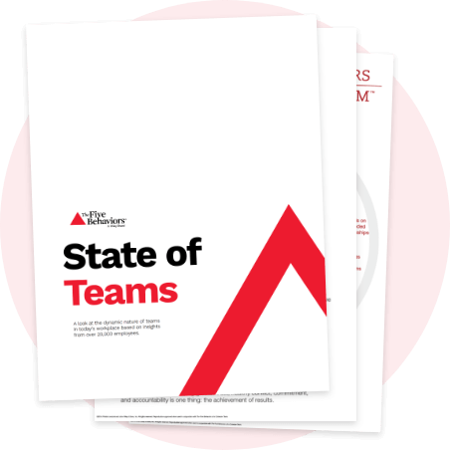
Learn more at discprofile.com

