Slide 1
Quotes on Results
Brought to you by Discprofile.com Authorized partner, The Five Behaviors™

Slide 2
The ultimate dysfunction of a team is the tendency of members to care about something other than the collective goals of the group.
Patrick Lencioni, The Five Dysfunctions of a Team

Slide 3
A functional team must make the collective results of the group more important to each individual than individual members’ goals.
Patrick Lencioni, The Five Dysfunctions of a Team

Slide 4
No amount of trust, conflict, commitment, or accountability can compensate for a lack of desire to win.
Patrick Lencioni, The Five Dysfunctions of a Team

Slide 5
“How did you do it?” we asked Don. “How did you make it to the top of Mount Rainier on one leg?”
“One hop at a time,” he said.
James M. Kouzes, The Leadership Challenge

Slide 6
How does a team go about ensuring that its attention is focused on results? By making results clear, and rewarding only those behaviors and actions that contribute to those results.
Patrick Lencioni, The Five Dysfunctions of a Team

Slide 7
Teams that are willing to commit publicly to specific results are more likely to work with a passionate, even desperate desire to achieve those results. Teams that say, “We’ll do our best,” are subtly, if not purposefully, preparing themselves for failure.
Patrick Lencioni, The Five Dysfunctions of a Team

Slide 8
Team leaders must be selfless and objective, and reserve rewards and recognition for those who make real contributions to the achievement of group goals.
Patrick Lencioni, The Five Dysfunctions of a Team

Slide 9
No one on a cohesive team can say, “Well, I did my job. Our failure isn’t my fault.”
Patrick Lencioni, The Advantage

Slide 10
There is no getting around the fact that the only measure of a great team—or a great organization—is whether it accomplishes what it sets out to accomplish.
Patrick Lencioni, The Advantage

Slide 11
No matter how good a leadership team feels about itself, and how noble its mission might be, if the organization it leads rarely achieves its goals, then, by definition, it’s simply not a good team.
Patrick Lencioni, The Advantage

Slide 12
Results-oriented teams establish their own measurements for success. They don’t allow themselves the wiggle room of subjectivity. But this is not easy, because subjectivity is attractive.
Patrick Lencioni, The Five Dysfunctions of a Team

Slide 13
When leaders preach teamwork but exclusively reward individual achievement, they are confusing their people and creating an obstacle to true team behavior.
Patrick Lencioni, The Advantage

Slide 14
When debriefing with your team, be sure to discuss how the results were impacted by group dynamics and interactions, rather than by pointing out the contributions of individual members.
John Rampton, Entrepreneur

Slide 15
However beautiful the strategy, you should occasionally look at the results.
Winston Churchill

Slide 16
Teamwork: The fuel that allows common people to attain uncommon results.
Andrew Carnegie, Industrialist and philanthropist

Slide 17
I attribute my success to this— I never gave or took any excuse.
Florence Nightingale, founder of modern nursing

Slide 18
The productivity of a work group seems to depend on how the group members see their own goals in relation to the goals of the organization.
Ken Blanchard, author and business consultant

Slide 19
Goals should be realistic, attainable, and shared among all members of the team.
Mike Krzyzewski, basketball coach

Slide 20
Individualism wins trophies, but teamwork wins championships.
Tommy Lasorda, baseball coach and manager

Slide 21
It’s not the will to win that matters—everyone has that. It’s the will to prepare to win that matters.
Bear Bryant, football coach

Slide 22
You have to expect things of yourself before you can do them.
Michael Jordan, basketball player

Slide 23
Goals are dreams with deadlines.
Diana Scharf Hunt, author

Slide 24
A person who stands at the fork, unable to pick, will never get anywhere.
Terry Goodkind, novelist, in Wizard’s First Rule

Slide 25
Knowing what must be done does away with fear.
Rosa Parks, civil rights activist

Slide 26
Don’t mistake activity with achievement.
John Wooden, basketball coach

Slide 27
Don’t be afraid to give up the good to go for the great.
John D. Rockefeller, business leader and philanthropist

Slide 28
You don't make progress by standing on the sidelines, whimpering and complaining. You make progress by implementing ideas.
Shirley Chisholm, Congressperson and presidential candidate

Slide 30
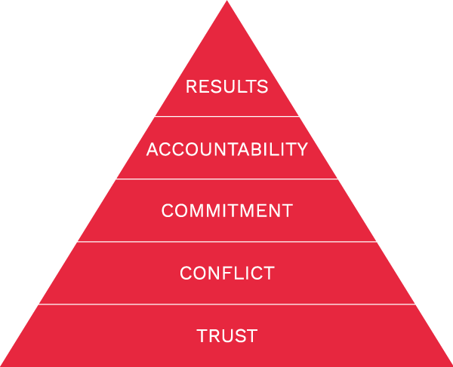
Results is one of The Five Behaviors of a Cohesive Team.
Learn more at Discprofile.com

