Slide 1
Quotes on Trust
Brought to you by discprofile.com
Authorized partner, The Five Behaviors™

Slide 2
Remember teamwork begins by building trust. And the only way to do that is to overcome our need for invulnerability.
Patrick Lencioni, author of The Five Dysfunctions of a Team

Slide 3
Trust is the lubrication that makes it possible for organizations to work.
Warren Bennis, pioneer in the field of Leadership Studies

Slide 4
Leaders know the importance of having someone in their lives who will unfailingly and fearlessly tell them the truth.
Warren Bennis, pioneer in the field of Leadership Studies

Slide 5
I’ve learned that people will forget what you said, people will forget what you did, but people will never forget how you made them feel.
Maya Angelou, author

Slide 6
When we think about the digital economy, we sometimes think that everything has to be new or revolutionary. But in the digital world, things like trust and integrity become even more important.
Arthur Yeung, Tencent Group

Slide 7
Trusting one another is something human beings do naturally. It activates brain systems that motivate teamwork, which, in the best case, makes work feel like play.
Paul J. Zak, author of Trust Factor: The Science of Creating High Performance Companies

Slide 8
Trust is the glue of life. It’s the most essential ingredient in effective communication. It’s the foundational principle that holds all relationships.
Stephen Covey, author of The 7 Habits of Highly Effective People

Slide 9
Learning to trust is one of life’s most difficult tasks.
Isaac Watts, theologian and logician

Slide 10
Whoever is careless with the truth in small matters cannot be trusted with important matters.
Albert Einstein, physicist

Slide 11
The trust of the people in the leaders reflects the confidence of the leaders in the people.
Paulo Freire, educator and philosopher

Slide 12
He who does not trust enough, will not be trusted.
Lao Tzu, philosopher

Slide 13
At the end of the day, the only thing we have going for us is being honest, being trusted, and being trusting. If we break that bond, it is almost impossible to earn it back.
William Weldon, retired CEO of Johnson & Johnson

Slide 14
Removing self-interest and personal glory from your motivation on the job is the single most important thing you can do to inspire trust.
Carol A. Walker, founder of Prepared to Lead

Slide 15
The chief lesson I have learned in a long life is that the only way you can make a man trustworthy is to trust him, and the surest way to make him untrustworthy is to distrust him.
Henry L. Stimson, American statesman

Slide 16
When you explain to people what you’re trying to do, as opposed to just making demands or delegating tasks, you can build instant trust, even if it’s just for that short time you’re on the phone.
Simon Sinek, author of Start With Why

Slide 17
Better to trust the person who is frequently in error than the one who is never in doubt.
Eric Sevareid, journalist and author

Slide 18
When trust improves, the mood improves.
Fernando Flores, engineer, entrepreneur, politician

Slide 19
You cannot shake hands with a clenched fist.
Indira Gandhi, former prime minister of India

Slide 20
Foster collaboration by promoting cooperative goals and building trust.
Jim Kouzes and Barry Posner, authors of The Leadership Challenge

Slide 21
When you form a team, why do you try to form a team? Because teamwork builds trust and trust builds speed.
Russel L. Honoré, American military leader

Slide 22
A lack of transparency results in distrust and a deep sense of insecurity.
The Dalai Lama

Slide 23
It is essential to employ, trust, and reward those whose perspective, ability, and judgment are radically different from yours. It is also rare, for it requires uncommon humility, tolerance, and wisdom.
Dee Hock, founder and former CEO of Visa

Slide 24
Would you want to do business with a person who was 99% honest?
Sidney Madwed, speaker and author

Slide 25
Trust reduces transaction costs; it reduces the need for litigation and speeds commerce; it actually lubricates organizations and societies.
Marilyn Carlson Nelson, former chairperson and CEO of Carlson

Slide 26
When one side benefits more than the others, that’s a win-lose situation. To the winner it might look like success for a while, but in the long run, it breeds resentment and distrust.
Stephen Covey, author of The 7 Habits of Highly Effective People

Slide 27
Trust is not simply a matter of truthfulness, or even constancy. We trust those who have our best interests at heart, and mistrust those who seem deaf to our concerns.
Gary Hamel, management consultant

Slide 28
Trust is not built in big, sweeping moments. It’s built in tiny moments every day.
Brené Brown, professor of social work and author of Dare to Lead

Slide 29
Accountability is hard. Blame is easy. One builds trust. The other destroys it.
Simon Sinek, author and speaker

Slide 30
Inspirational leaders need to have a winning mentality in order to inspire respect. It is hard to trust in the leadership of someone who is half-hearted about their purpose, or only sporadic in focus or enthusiasm.
Sebastian Coe, British politician

Slide 31
Our approach is based on the major findings of 20 years of research—that trust between managers and employees is the primary defining characteristic of the very best workplaces.
Great Places to Work Institute

Slide 32
Having spent many years trying to define the essentials of trust, I arrived at the position that if two people could say two things to each other and mean them, then there was the basis for real trust. The two things were “I mean you no harm” and “I seek your greatest good.”
Jim Meehan, British psychologist and poet

Slide 33
It’s been my experience that the people who gain trust, loyalty, excitement, and energy fast are the ones who pass on the credit to the people who have really done the work.
Robert Townsend, former CEO of Avis

Slide 34
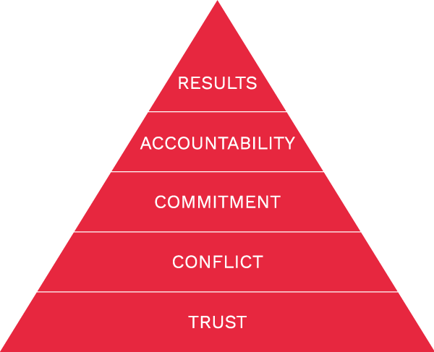
Trust is the foundation of The Five Behaviors of a Cohesive Team.
Learn more at Discprofile.com

