Slide 1
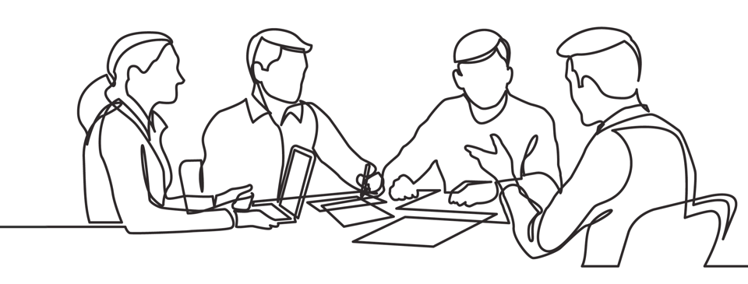

Quotes on Accountability
Brought to you by Discprofile.com
Authorized partner, The Five Behaviors™

Slide 2
The only way we succeed as a group is not simply following directions, but in keeping each other accountable for our actions.
A. J. Darkholme, author and poet

Slide 3
We have a deeply held association between accountability and punishment—instead of considering it a tool to help people unlock their highest self.
Jonathan Raymond, Do You Understand What Accountability Really Means?, Harvard Business Review

Slide 4
Open collaboration encourages greater accountability, which in turn fosters trust.
Ron Garan, NASA astronaut

Slide 5
Our study showed that when accountability processes are seen as unfair, people feel forced to embellish their accomplishments and hide, or make excuses for their shortfalls.
Ron Carucci, 4 Ways Lying Becomes the Norm at a Company, Harvard Business Review

Slide 6
It is not only what we do, but also what we do not do, for which we are accountable.
Molière, French playwright and actor

Slide 7
I think that we often think of accountability as finger-pointing or who are we going to blame, when it’s really about resolving problems.
Courtney Lynch, author of Spark: How to Lead Yourself and Others to Greater Success

Slide 8
All businesses are about people first—because the only way we can build genuinely successful businesses is to build lasting relationships inside and outside the company. We do that by holding ourselves accountable, by doing what we say we are going to do, and by inspiring others to strive for something bigger than themselves.
Mary Barra, General Motors CEO

Slide 9
You fail all the time, but you aren’t a failure until you start blaming someone else.
Bum Philips, American football coach

Slide 10
Ninety-nine percent of all failures come from people who have a habit of making excuses.
George Washington Carver, botanist and inventor

Slide 11
Responsibility equals accountability equals ownership. And a sense of ownership is the most powerful weapon a team or organization can have.
Pat Summitt, Hall of Fame basketball coach

Slide 12
On good teams, coaches hold players accountable. On great teams, players hold players accountable.
Joe Dumars, NBA basketball player and executive

Slide 13
If you are building a culture where honest expectations are communicated and peer accountability is the norm, then the group will address poor performance and attitudes.
Henry Cloud, clinical psychologist and author

Slide 14
Our goal is to be clear about the courteous culture, open communication, financial discipline, and efficient operations that Delta should maintain. Some of the rules are extremely specific—for example, “Don’t interrupt”—because we believe that behavior matters. That is how you demonstrate values.
Richard H. Anderson, CEO of Delta

Slide 15
On one side of accountability is courage, on the other is freedom.
Jean Hamilton-Fford, author, educator, artist

Slide 16
Accountability is not a technology issue, and it’s not a process issue. It’s a people issue—it’s a cultural issue.
Stephen Gold, EVP and CIO of CVS Health

Slide 17
Clear accountability is a necessary feature of a high-trust culture.
Joel Peterson, JetBlue chairman and author of The 10 Laws of Trust

Slide 18
Holding individuals accountable for their judgments and actions increases the likelihood that they will be vigilant about eliminating bias from their decision making.
John Beshears & Francesca Gino, Leaders as Decision Architects, Harvard Business Review

Slide 19
Leaders inspire accountability through their ability to accept responsibility before they place blame.
Courtney Lynch, author of Spark: How to Lead Yourself and Others to Greater Success

Slide 20
When we fail to set boundaries and hold people accountable, we feel used and mistreated. This is why we sometimes attack who they are, which is far more hurtful than addressing a behavior or a choice.
Brené Brown, scholar, author, and public speaker

Slide 21
When it comes to privacy and accountability, people always demand the former for themselves and the latter for everyone else.
David Brin, scientist and author

Slide 22
Accountability breeds response-ability.
Stephen Covey, author of The 7 Habits of Highly Effective People

Slide 23
We need to accept that we won’t always make the right decisions, that we’ll screw up royally sometimes—understanding that failure is not the opposite of success, it’s part of success.
Arianna Huffington, co-founder of The Huffington Post

Slide 24
In the weakest teams, there is no accountability.
In mediocre teams, bosses are the source of accountability.
In high performance teams, peers manage the vast majority of performance problems with one another.
Joseph Grenny, author, speaker, and social scientist

Slide 25
Many leaders believe that holding people accountable is the key to getting the results they want. There’s one problem with this, though: Sometimes we get frustrated with people for not meeting our expectations when we have never communicated what they were in the first place.
Anne Grady, author and corporate leadership expert

Slide 26
Accountability is hard. Blame is easy. One builds trust. The other destroys it.
Simon Sinek, author and speaker

Slide 27
I’ve learned that nothing builds engagement more than being accountable to the people in your organization. You simply have to have the confidence to own your mistakes and admit when you’re wrong.
Jim Whitehurst, CEO of Red Hat

Slide 28
Being a leader doesn’t mean that you’re always right or that you won’t err. What being a leader does mean is airing the reasons for why you did something and then making yourself accountable for the results—even if those you’re accountable to don’t directly work for you.
Jim Whitehurst, CEO of Red Hat

Slide 29
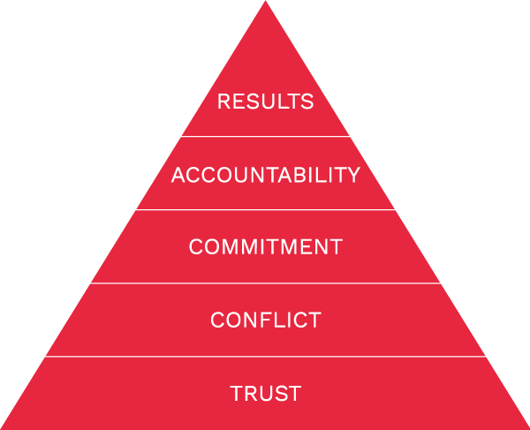
Accountability is one of The Five Behaviors of a Cohesive Team.
Learn more at Discprofile.com

