Slide 1
Quotes on Commitment
Brought to you by discprofile.com
Authorized partner, The Five Behaviors™

Slide 2
Commitment is a function of two things: clarity and buy-in.
Patrick Lencioni, The Five Dysfunctions of a Team

Slide 3
It’s as simple as this. When people don’t unload their opinions and feel like they’ve been listened to, they won’t really get on board.
Patrick Lencioni, The Five Dysfunctions of a Team

Slide 4
The difference between involvement and commitment is like ham and eggs. The chicken is involved; the pig is committed.
Martina Navratilova, professional tennis player and coach

Slide 5
People cannot fully commit unless whatever they are being asked to commit to fits with their own beliefs.
James M. Kouzes and Barry Z. Posner, Turning Adversity Into Opportunity

Slide 6
Being fully committed is what keeps you and your constituents on track and willing to struggle through hard times.
James M. Kouzes and Barry Z. Posner, Turning Adversity Into Opportunity

Slide 7
Real buy-in involves at least some element of co-creation. It invites discussion, debate, and allows everyone to feel even more vested in the outcome.
Kristi Hedges, author of The Inspiration Code

Slide 8
Commitment is healthiest when it is not without doubt but in spite of doubt.
Rollo May, psychologist, in The Courage to Create

Slide 9
The two greatest causes of the lack of commitment are the desire for consensus and the need for certainty.
Patrick Lencioni, The Five Dysfunctions of a Team

Slide 10
A decision is better than no decision.
Patrick Lencioni, The Five Dysfunctions of a Team

Slide 11
It is better to make a decision boldly and be wrong—and then change direction with equal boldness—than it is to waffle.
Patrick Lencioni, The Five Dysfunctions of a Team

Slide 12
Individual commitment to a group effort—that is what makes a team work, a company work, a society work, a civilization work.
Vince Lombardi, football coach

Slide 13
Managers can threaten people with the loss of jobs if they don’t get with the program, but threats, power, and position do not earn commitment. They earn compliance.
James M. Kouzes and Barry Z. Posner, Credibility

Slide 14
People commit to causes, not to plans.
James M. Kouzes, A Leader’s Legacy

Slide 15
Reasonable human beings do not need to get their way in order to support a decision, but only need to know that their opinions have been heard and considered.
Patrick Lencioni, The Five Dysfunctions of a Team

Slide 16
Contrary to popular wisdom, the mark of a great meeting is not how short it is or whether it ends on time. The key is whether it ends with clarity and commitment from participants.
Patrick Lencioni, The Five Dysfunctions of a Team

Slide 17
If people don’t weigh in, they can’t buy in.
Patrick Lencioni, The Advantage

Slide 18
Great teams ensure that everyone’s ideas are genuinely considered, which then creates a willingness to rally around whatever decision is ultimately made by the group.
Patrick Lencioni, The Five Dysfunctions of a Team

Slide 19
If you could get all the people in an organization rowing in the same direction, you could dominate any industry, in any market, against any competition, at any time.
Patrick Lencioni, The Five Dysfunctions of a Team

Slide 20
Great teams make clear and timely decisions and move forward with complete buy-in from every member of the team, even those who voted against the decision. They leave meetings confident that no one on the team is quietly harboring doubts about whether to support the actions agreed on.
Patrick Lencioni, The Five Dysfunctions of a Team

Slide 21
Questions to help people decide if they can more fully commit:
Why are we doing what we’re doing?
What’s the larger purpose?
Why does what we’re doing matter?
What are we really passionate about?
What important shared values and beliefs can we emphasize to keep people engaged?
Who’s counting on us? Who cares about and depends on the quality, innovativeness, and efficiency of our efforts?
James M. Kouzes and Barry Z. Posner, Turning Adversity Into Opportunity

Slide 22
Teams that are willing to commit publicly to specific results are more likely to work with a passionate, even desperate desire to achieve those results. Teams that say, “We’ll do our best,” are subtly, if not purposefully, preparing themselves for failure.
Patrick Lencioni, The Five Dysfunctions of a Team

Slide 23
Commitment is what transforms a promise into reality.
Abraham Lincoln, American president

Slide 24
In any moment of decision, the best thing you can do is the right thing, the next best thing is the wrong thing, and the worst thing you can do is nothing.
Theodore Roosevelt, American president

Slide 25
More important than the quest for certainty is the quest for clarity.
François Gautier, Journalist

Slide 26
When you make a commitment, you build hope. When you keep it, you build trust.
Stephen R. Covey, author, paraphrasing Roger Merrill

Slide 27
Objectives are not fate; they are direction.
Peter Drucker, management consultant and author, in People and Performance

Slide 28
Change is disturbing when it is done to us, exhilarating when it is done by us.
Rosabeth Moss Kanter, founding chair & director, Harvard University Advanced Leadership Initiative

Slide 29
There are a hundred valid reasons why something can’t be done, but only one reason, commitment, why it can.
Jonathan Lockwood Huie, author

Slide 30
Growth and comfort do not coexist.
Ginni Rometty, former CEO, IBM

Slide 31
There’s a difference between knowing the path and walking the path.
Morpheus in The Matrix, written by Lana and Lilly Wachowski

Slide 32
Alone, we can do so little; together, we can do so much.
Helen Keller, author

Slide 33
Man cannot discover new oceans unless he has the courage to lose sight of the shore.
Andre Gide, Autumn Leaves

Slide 34
Sticks in a bundle are unbreakable.
Proverb

Slide 36
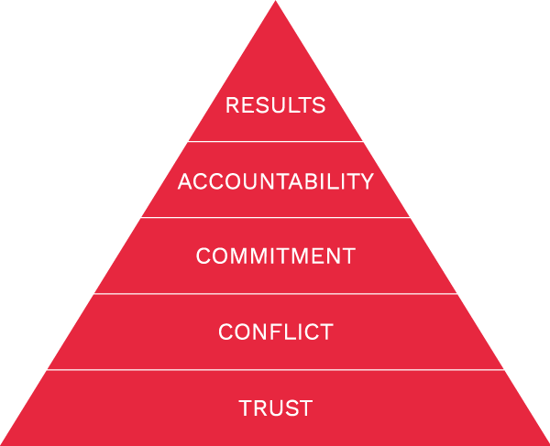
Commitment is one of The Five Behaviors of a Cohesive Team.
Learn more at Discprofile.com

