Slide 1

Our favorite quotes about teamwork

Slide 2
Teams are more productive and innovative than mere work groups. They produce results that exceed what groups of individuals can do through simple cooperation and coordination.
― Linda Hill & Kent Lineback
“Good Managers Lead Through a Team” Harvard Business Review

Slide 3
Wearing the same shirts doesn't make a team.
― Buchholz and Roth

Slide 4
Every high-performing team believes it exists for a compelling reason and that the world will be better for what it does. Its purpose is not the task or work it does but the benefit it delivers.
― Linda Hill & Kent Lineback
“Good Managers Lead Through a Team” Harvard Business Review

Slide 5
Identification with the group’s success is more likely to ensure that people will say what they know, regardless of whether it fits ‘the party line’.
― Cass R. Sunstein and Reid Hastie
“Making Dumb Groups Smarter” Harvard Business Review

Slide 6
Talent wins games, but teamwork and intelligence wins championships.
― Michael Jordan

Slide 7
As a manager, my number one job is to hire the best people and develop them. It’s really about the team and the people you build around you.
– Stacy Brown-Philpot, CEO, TaskRabbit

Slide 8
All teams – regardless of their level of performance – set objectives, create a vision, allocate tasks to complement each other, and shed poorly performing people. Accelerating teams simply do these things faster and more effectively than lagging teams.
– Colin Price and Sharon Toye
The Acceleration Factor, S+B blog

Slide 9
Good leaders organize and align people around what the team needs to do. Great leaders motivate and inspire people with why they’re doing it.
– Marillyn Hewson
Innovation with Purpose

Slide 10
The role of a leader of innovation is not to set a vision and motivate others to follow it. It’s to create a community that is willing and able to generate new ideas.
– Linda A Hill, Greg Brandeau, Emily Truelove, and Kent Lineback
“Collective Genius” Harvard Business Review

Slide 11
Collaboration should involve passionate disagreement.
– Linda A Hill, Greg Brandeau, Emily Truelove, and Kent Lineback
“Collective Genius” Harvard Business Review

Slide 12
Teams are more innovative when members have a common under-standing of team objectives and are also committed to them.
– Robert Schwarz, “What the Research Tells Us
About Team Creativity and Innovation” Harvard Business Review

Slide 13
To build willingness [to innovate], leaders must create communities that share a since of purpose, values, and rules of engagement.
– Linda A Hill, Greg Brandeau, Emily Truelove, and Kent Lineback
“Collective Genius” Harvard Business Review

Slide 14
If you take out the team in teamwork, it's just work.
Now who wants that?
― Matthew Woodring Stover

Slide 15
In every team, ‘we’ trumps ‘I.’ Unless you’ve been part of a team yourself, it’s hard to understand the exhilaration produced by this sense of what ‘we’ can accomplish together.
― Linda Hill & Kent Lineback
“Good Managers Lead Through a Team” Harvard Business Review

Slide 16
The greater the loyalty of a group toward the group, the greater is the motivation among the members to achieve the goals of the group, and the greater the probability that the group will achieve its goals.
― Rensis Likert

Slide 17
The rhetoric of innovation is often about fun and creativity, but the reality is that innovation can be very taxing and uncomfortable.
– Linda A Hill, Greg Brandeau, Emily Truelove, and Kent Lineback
“Collective Genius” Harvard Business Review

Slide 18
Teamwork is the secret that makes common people achieve uncommon results.
― Ifeanyi Enoch Onuoha

Slide 19
When a team outgrows individual performance and learns team confidence, excellence becomes a reality.
― Joe Paterno

Slide 20
Teamwork is the ability to work together toward a common vision. The ability to direct individual accomplishments toward organizational objectives. It is the fuel that allows common people to attain uncommon results.
― Andrew Carnegie

Slide 21
There's something beautifully friendly and elevating about a bunch of guys playing music together. … It's really teamwork, one guy supporting the others, and it's all for one purpose, and there's no flies in the ointment, for a while.
― Keith Richards, Life

Slide 22
The nice thing about teamwork is that you always have others on your side.
― Margaret Carty

Slide 23
We cannot win in team situations or in relationships by ourselves. It is like trying to pick up a pencil with only one finger...Even if that one finger is extremely strong, it will prove almost impossible to pick up that pencil unless you use your other fingers…. Teamwork is a bit like using all of your fingers. Each one is unique and contributes something different, but they unite in pursuit of a common goal.
― Terry Orlick

Slide 24
All too often, leaders and their groups solve problems through domination or compromise, resulting in less-than-inventive solutions.
– Linda A Hill, Greg Brandeau, Emily Truelove, and Kent Lineback
“Collective Genius” Harvard Business Review

Slide 25
Surround yourself with a great team and build that team slowly. … Your team is one of your most important investments, and if you are careful about hiring only the best people, it will pay dividends.
– Sheila Johnson, funder and CEO, Salamander Hotels & Resorts

Slide 26
Interdependent people combine their own efforts with the efforts of others to achieve their greatest success.
– Stephen Covey

Slide 27
The more that people know how they fit on a team, the more they will desire to properly make the most of their fit and maximize their contribution.
– John C. Maxwell

Slide 28
I invite everyone to choose forgiveness rather than division, teamwork over personal ambition.
― Jean-Francois Cope

Slide 29
The greatest and most inspiring mountain climbing achievements in history are not so much stories of individual achievement, but are stories of the extraordinary power of a unified, talented, prepared team that stays loyally committed to one another and to their shared vision to the end.
– Stephen Covey

Slide 30
If you want to go fast,
go alone.
If you want to go far,
go together.
― African proverb

Slide 31
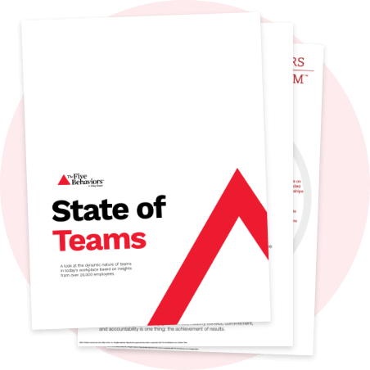
Learn more at discprofile.com

