Slide 1

Lessons from the 8 Dimensions of Leadership
Leadership strategies based on DiSC®

Slide 2
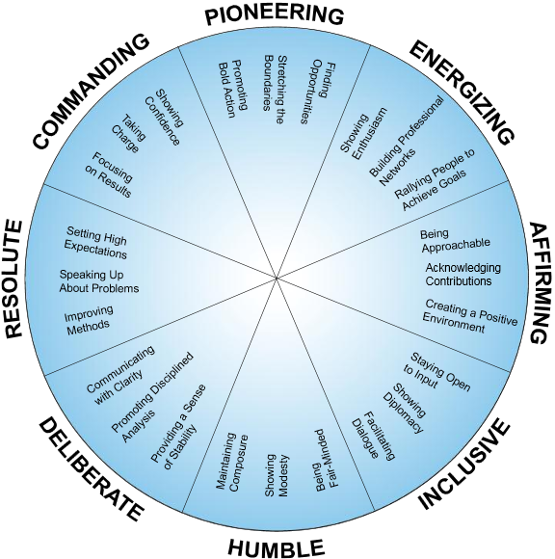
Expand your perspective.
Shape your leadership style to match your current situation.
What lessons can you learn from each of the eight dimensions of leadership?
When would each style best serve your organization?

Slide 3

Pioneering leaders
They tend to be good at initiating change.
They often trust their gut instincts.
They’re able to bring people together to achieve their goals.
They tend to be inspiring.
DiSC® style iD or Di.

Slide 4
Leaders are pioneers—people who are willing to step out into the unknown. They search for opportunities to innovate, grow, and improve.
Jim Kouzes and Barry Posner

Slide 5
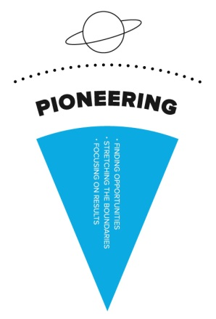
To be more Pioneering
Actively seek new opportunities beyond your organization’s walls.
Break some glass. Stray away from your comfort zone.
Learn to take leaps of faith.

Slide 6

Energizing leaders
They’re able to rally people around group goals.
They tend to look on the bright side.
They’re comfortable being in the spotlight.
They’re often accepting of other people’s ideas.
DiSC® style i.

Slide 7
Great leaders energize people to go the extra mile. They set stretch goals that motivate people to accomplish more than they think is possible.
Jack Zenger and Joe Folkman

Slide 8

To be more Energizing
Make an effort to build enthusiasm for the group’s goals.
Be intentional about making connections with a wide variety of people.
Learn to lead the rally.

Slide 9
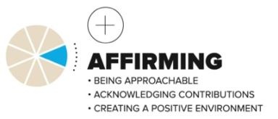
Affirming leaders
They tend to be friendly and approachable.
They’re often generous in their praise.
They’re able to consider the needs of different groups of people.
They’re less concerned with their own ego needs.
DiSC® style iS or Si.

Slide 10
The quality of a leader cannot be judged by the answers he gives, but by the questions he asks.
Simon Simek

Slide 11
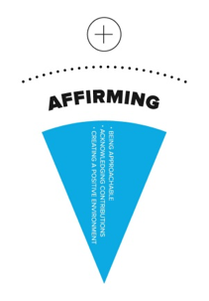
To be more Affirming
Monitor your “default” expressions.
Let people know that you value them.
Accept other people’s limitations.

Slide 12

Inclusive leaders
They tend to be very people-oriented.
They’re often able to create a warm, safe environment.
They’re able to overlook other people’s flaws.
They tend to deliver reliable results.
DiSC® style S.

Slide 13
Only the leader can set the tone of the dialogue in the organization. Dialogue is the core of culture and the basic unit of work. How people talk to each other absolutely determines how well the organization will function.
Larry Bossidy and Ram Charan

Slide 14
To be more Inclusive
Show people that you’re open to their ideas.
Monitor your emotional output carefully.
Work to facilitate two-way discussion on important issues.

Slide 15

Humble leaders
They’re often able to head off potential problems with careful planning.
They provide others with the tools necessary to do their work.
They maintain their composure, even under stress.
DiSC® style SC or CS.

Slide 16
Don’t flaunt your authority. Humility will make you approachable. It opens the door to building relationships.
Jack Zenger and Joe Folkman

Slide 17

To be more Humble
Maintain your composure by keeping things in perspective.
Take the time to listen to the less powerful people around you.
Make the needs of your group a priority.

Slide 18
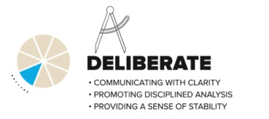
Deliberate leaders
They’re determined to get things done right.
They’re often able to separate emotions from facts.
They take the time to create systems and structures.
DiSC® style C.

Slide 19
Whatever surprises leaders themselves may face, they don’t create any for the group. Leaders are all of a piece; they stay the course.
Warren Bennis

Slide 20

To be more Deliberate
Be deliberate in your communication.
Show that you’ve done your homework.
Pay attention to process management tools and methods.

Slide 21
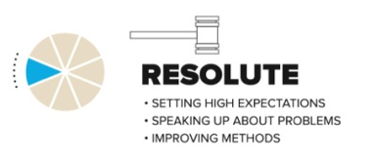
Resolute leaders
They tend to be good problem solvers.
They’re often able to push their way through obstacles.
They’re able to hold people accountable.
They’re often able to identify potential weaknesses in plans.
DiSC® style CD or DC.

Slide 22
The expectations that successful leaders hold provide the framework into which people fit their own realities.
Jim Kouzes and Barry Posner

Slide 23

To be more Resolute
Learn to hold people accountable.
Find and address problems.
Get comfortable making unpopular decisions.

Slide 24

Commanding leaders
They are able to set and stick to aggressive timelines.
They tend to be very goal-oriented.
They’re able to speak with conviction.
They’re not afraid to take some risks.
DiSC® style D.

Slide 25
Psychologically, leaders lead because they convince others that they understand the issues better than anyone else. People follow them because they speak about solutions with persuasive conviction, project confidence when others are uncertain, and act decisively.
Judith Bardwick

Slide 26
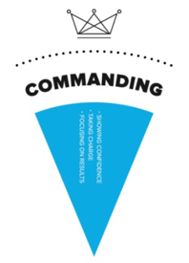
To be more Commanding
Get comfortable with making firm, public commitments
Learn to act without permission.
Create some urgency.

Slide 27
Learn more at discprofile.com
The 8 Dimensions of Leadership: DiSC Strategies for Becoming a Better Leader
Everything DiSC leadership styles, discprofiles.com blog
Curious about your own style? Take this quick leadership assessment.

