Slide 1

Quotes about conflict
Conflict can be productive

Slide 2
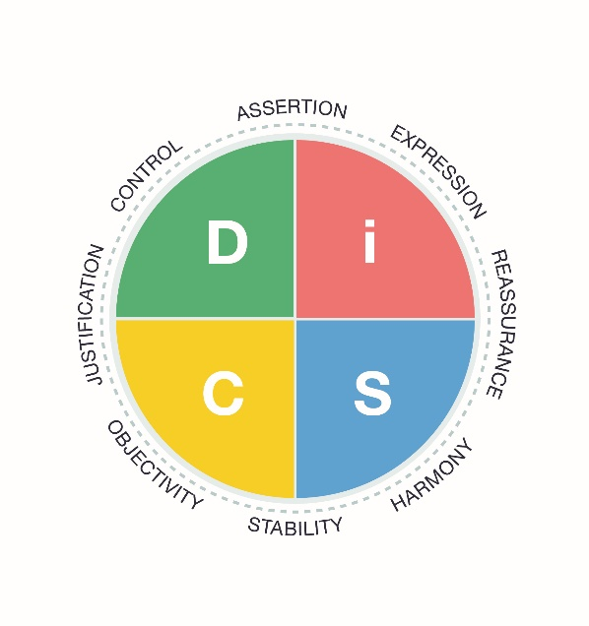
These quotes can be used to generate discussion before or after learners complete the Everything DiSC® Productive Conflict profile.
Note to facilitators: Have your own answers and stories ready to share.

Slide 3

The need for conflict
Conflict includes heated discussions, opposition between ideas, or any difference of opinions involving strong emotions.

Slide 4
Conflict can have a positive side, one that builds relationships, creates coalitions, fosters communication, strengthens institutions, and creates new ideas, rules and laws. These are the functions of conflict.
― United Nations training manual: Skills Development For Conflict Transformation

Slide 5
What we need is collaboration where tension, disagreement, and conflict improve the value of the ideas, expose the risks inherent in the plan, and lead to enhanced trust among the participants.
― Liane Davey, If Your Team Agrees on Everything, Working Together is Pointless, HBR

Slide 6
Teams need conflict to function effectively. Conflict allows the team to come to terms with difficult situations, to synthesize diverse perspectives, and to make sure solutions are well thought out.
― Liane Davey, psychologist and business strategist

Slide 7

Discussion
Share an example of when conflict helped a team you were on produce better work, consider alternatives, reframe an issue, infuse the group with needed energy, increase participation, or have another positive result.
How did you and the group feel after a resolution was determined? Was your team more cohesive as a result of this joint struggle?

Slide 8
Contrary to popular wisdom and behavior, conflict is not a bad thing for a team. In fact, the fear of conflict is almost always a sign of problems.
― Patrick Lencioni, author of The Five Dysfunctions of a Team

Slide 9
Discussion
Do you fear conflict?
Do you think your team fears conflict?
Why? In what situations?

Slide 10

Conflict is not comfortable.

Slide 11
Conflict is uncomfortable, but it is the source of true innovation and also a critical process in identifying and mitigating risks.
― Liane Davey, psychologist and business strategist

Slide 12
Discussion
What are some things that can make you uncomfortable during conflict?
Examples: Yelling, belittling, watching someone cave in, defensiveness, passive-aggression.
What approaches to conflict do you value? Examples: staying objective, being straightforward, encouraging open dialogue, being flexible, tact, active listening.

Slide 13
Remember that any conflict feels awkward — “healthy” conflict feels no less uncomfortable for being “healthy.”
― Mark de Rond, Conflict Keeps Teams at the Top of Their Game, Harvard Business Review

Slide 14
Discussion
How does your body respond to destructive conflict?
How does your body respond to constructive conflict?
Can you sense when you’re about to act out of fear, anxiety, or anger?
How can you best act constructively while still feeling uncomfortable?

Slide 15
Fighting with a colleague feels like fighting with a friend or a sibling. Fighting with people who have more or less power than we do feels like bullying.
― Annie McKee, Why We Fight at Work, Harvard Business Review

Slide 16
Discussion
What did you learn about conflict in your home and schools?
Do you ever feel compassion for the other person or people in conflict?

Slide 17
When we are not emotionally entangled in an issue, we know that conflict is normal, that it can be resolved—or at least managed. But when feelings get stirred up, most of us are thrown off balance.
― Holly Weeks, Taking the Stress Out of Stressful Conversations, Harvard Business Review

Slide 18
Discussion
What are some strategies you and your team could try when feelings become overwhelming or when conflict isn’t productive?

Slide 19

You can choose how you will respond to conflict.

Slide 20
Discussion
What does the following quote mean to you?

Slide 21
Conflict is inevitable, but combat is optional.
― Max Lucado

Slide 22
We all know from past experience, for instance, what kinds of conversations and people we handle badly. … Once you know what your danger zones are, you can anticipate your vulnerability and improve your response.
― Holly Weeks, Taking the Stress Out of Stressful Conversations, Harvard Business Review

Slide 23
Discussion
How can we learn more about our “danger zones”? What triggers them? What is your
go-to positive response? What’s your typical negative response?
Positive examples: straightforward with my opinions, focus on the facts, am empathetic, am tactful.
Negative examples: impatient, defensive, critical, withdraws, becomes dramatic, overpowers.

Slide 24
Collaboration should involve passionate disagreement.
― Hill, Brandeau, Truelove, and Lineback, Collective Genius, Harvard Business Review

Slide 25
Discussion
Have you ever stayed silent because you didn’t want to disrupt the group? Have you ever gone along with something you didn’t quite understand or agree with? Have you ever tacitly agreed to something but privately worked against it?

Slide 26
[Healthy conflict is] built on the rules and code of ethics established as part of company culture. These must be built into your into your company’s cultural DNA from day one on a foundation of trust and respect.
― David Roth, Supporting Healthy Conflict in the Workplace, Forbes

Slide 27
Discussion
What are your team’s rules of engagement? If you have never discussed them or reviewed them, now is a good time to begin.

Slide 28
Healthy conflict is impossible with a bully.
― David Roth, Supporting Healthy Conflict in the Workplace, Forbes

Slide 29
Discussion
How will your team hold each other accountable for inappropriate behavior during conflict?

Slide 30

Embracing conflict

Slide 31
Disagreements and debate at work are healthy. Fighting is not.
― Annie McKee, Why We Fight at Work, Harvard Business Review

Slide 32
Discussion
How can you tell the difference between debate and fighting? Does everyone in your workplace draw the same lines between the two behaviors?

Slide 33
Silence—not dissent—is the one answer that leaders should refuse to accept.
― Warren Bennis, pioneer in the field of Leadership Studies

Slide 34
Discussion
How might silence be detrimental to a team and to team goals? How can you encourage others in your workplace to speak up more often and constructively?

Slide 35
Managers need to know how to create teams that feel psychologically safe enough for conflicting opinions to be aired and the benefits of diversity exploited.
― Mark de Rond, Conflict Keeps Teams at the Top of Their Game, Harvard Business Review

Slide 36
Discussion
How are managers increasing the psychological safety of teams in your organization?
Examples: Listening to understand. Discussing the issue of psychological safety. Going through the Five Behaviors™ program together.

Slide 37
Real experts seek out constructive, even painful feedback.
― Ericsson, Prietula, and Cokely, The Making of an Expert, Harvard Business Review

Slide 38
Discussion
Share examples of how you’ve received feedback for which you were ultimately grateful. How was it given? Did you immediately appreciate it?
How does your team or workplace seek out constructive feedback from each other, from your leadership, from your clients or customers?

Slide 39
It’s easy to become aggravated by other people’s actions and forget what you were trying to achieve in the first place.
― Jeffrey Pfeffer, Win at Workplace Conflict, Harvard Business Review

Slide 40
Discussion
Are all members of your team working towards the same goal? What is it? Is your organization’s vision and mission clear and concise enough that you can return to it when conflict arises?

Slide 41
Sometimes people fight over personalities, but often they have a reason for being in conflict.
― Jeffrey Pfeffer, Win at Workplace Conflict, Harvard Business Review

Slide 42
Discussion
What are some common reasons for conflict in your workplace? Do people or units have competing goals or compete for resources? Do individuals have differing priorities? Are you sometimes like the blind men and the elephant, looking at the same problem but from differing vantage points?

Slide 43
When a woman expresses anger, we immediately associate it as a product of her personality: ‘She’s just an angry woman.’ When a guy expresses anger, it’s [seen as] a product of external circumstances. It’s objective.
― The “mean man” advantage, Quartz at Work

Slide 44
Discussion
Have you discussed how differences such as gender, ethnicity, age or race can alter the rules for individuals engaging in conflict? How can you address these issues?

Slide 45
Great teams avoid the consensus trap by embracing a concept that Intel, the legendary microchip manufacturer, calls “disagree and commit.”
― Patrick Lencioni, author of The Five Dysfunctions of a Team

Slide 46
Discussion
Does your team always need to reach consensus? If not, how will you determine when it’s time to “disagree and commit”? How can you encourage disagreement before the time for commitment?

Slide 47
Explicit self-awareness will often help save you from engaging in a conversation in a way that panders to your feelings rather than one that serves your needs.
― Holly Weeks, Taking the Stress Out of Stressful Conversations, Harvard Business Review

Slide 48
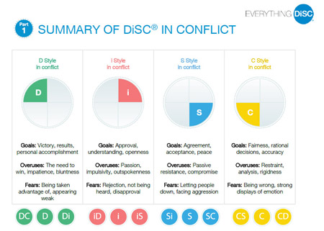
Gain more self-awareness by taking the Everything DiSC Productive Conflict assessment and reading your profile.

Slide 49
Learn more at discprofile.com
Everything DiSC© Productive Conflict map

Slide 50
Links
If Your Team Agrees on Everything, Working Together Is Pointless
Conflict Keeps Teams at the Top of Their Game
Why We Fight at Work
Taking the Stress Out of Stressful Conversations
Collective Genius
Supporting Healthy Conflict In The Workplace
The Making of an Expert
Win at Workplace Conflict
The “mean man” advantage

