Slide 1

Customer service
Based on the Everything Disc Model

Slide 2
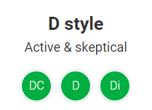
Working with a D style
Be business-like and get to the point quickly.
Respond to their task-related needs.
Ask “what” and “big picture” questions.
Accept their bluntness.
Let them lead the conversation.
Show confidence in your abilities and in theirs.

Slide 3
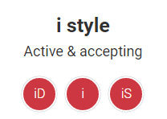
Working with an i style
Be casual and open.
Be enthusiastic and friendly.
Ask “who” questions. Let them talk.
Respond with empathy to their feelings or doubts.
Inspire them to action.
Meet their need to “look good.”

Slide 4
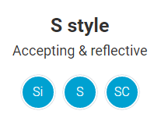
Working with an S style
Be informal, low pressure and patient.
Be methodical in your demonstrations.
Be sincere and build rapport.
Ask “how” questions.
Offer ongoing support.
Probe for unspoken concerns.

Slide 5
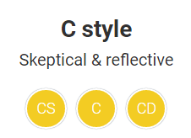
Working with a C style
Get down to business quickly, but tactfully.
Offer reassuring evidence or data.
Let them be the expert.
Be prepared to respond to “why” questions.
Offer options and help them clarify their priorities.
Summarize your agreements and follow up.

Slide 6
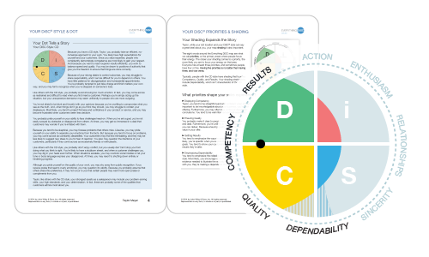
Learn more with
an Everything DiSC Sales profile.

