Slide 1

DiSC Personality Types
Based on the Everything DiSC Model

Slide 2
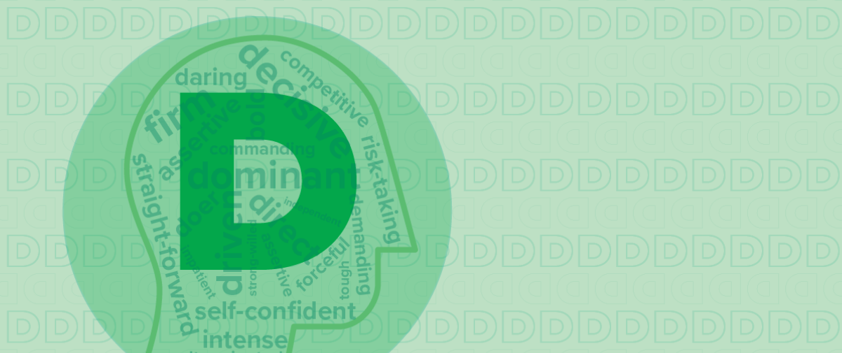
D style
Driven
Direct
Decisive
Strong-willed
Self-confident
Daring
Determined
Fast-paced

Slide 3

D style
Motivated by power and authority, winning, competition, and success.
Values competency, concrete results, and personal freedom.
Fears loss of control, being taken advantage of, and vulnerability.

Slide 4



D styles and their priorities
Challenge
Results
Accuracy
Results
Action
Challenge
Action
Results
Enthusiasm

Slide 5
D style quote
What’s the point of playing if winning isn’t the goal?
J.D. Robb, author

Slide 6

  Communicating with D styles
Give them the bottom line.
Be brief and speak up.
Focus your discussion narrowly.
Avoid generalizations.
Refrain from repeating yourself.
Focus on solutions rather than problems.

Slide 7
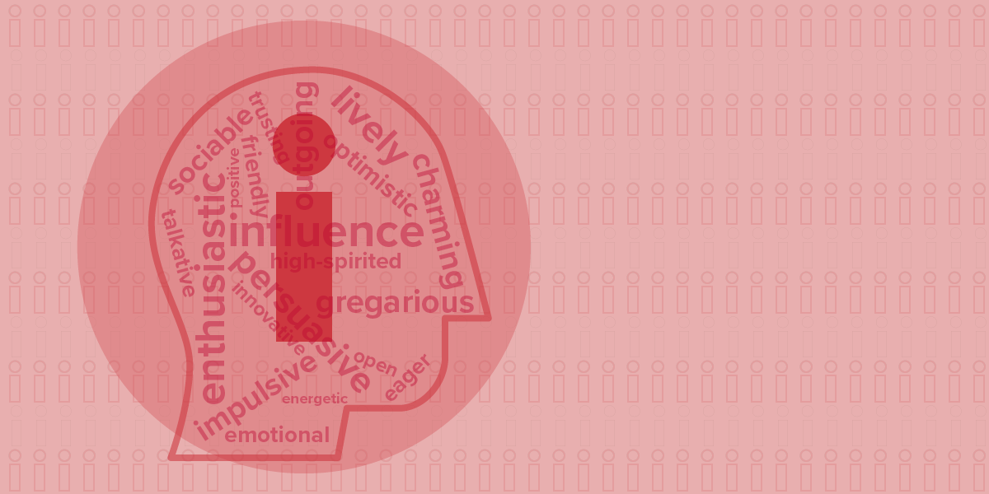
i style
Charming
Collaborative
Energizing
Trusting
Enthusiastic
Impulsive
Optimistic
Persuasive

Slide 8

i style
Motivated by social recognition, group activities, and relationships.
Values coaching and counseling, freedom of expression, and individuality.
Fears social rejection, disapproval, loss of influence, and being ignored.

Slide 9



i styles and their priorities
Action
Enthusiasm
Results
Enthusiasm
Action
Collaboration
Collaboration
Enthusiasm
Support

Slide 10
i style quote
Whoever is happy will make others happy too.
Anne Frank

Slide 11
Communicating with i styles
Share your experiences.
Allow them time to ask questions and talk.
Focus on the positives.
Avoid overloading them with details.
Don’t interrupt them.
Show respect for their spontaneity, high energy, and optimism.

Slide 12
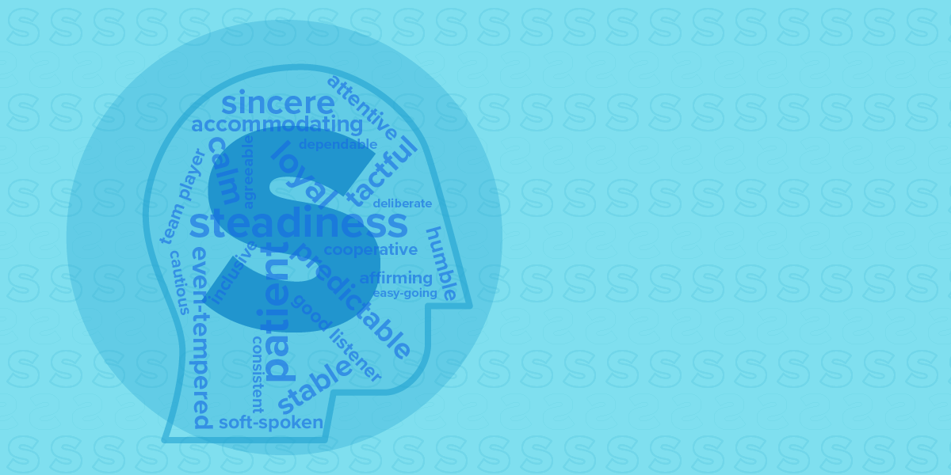
S style
Calm
Patient
Predictable
Deliberate
Stable
Warm
Passive
Loyal

Slide 13

S style
Motivated by cooperation, opportunities to help, and sincere appreciation.
Values loyalty, helping others, and security.
Fears loss of stability, change, loss of harmony, and offending others.

Slide 14
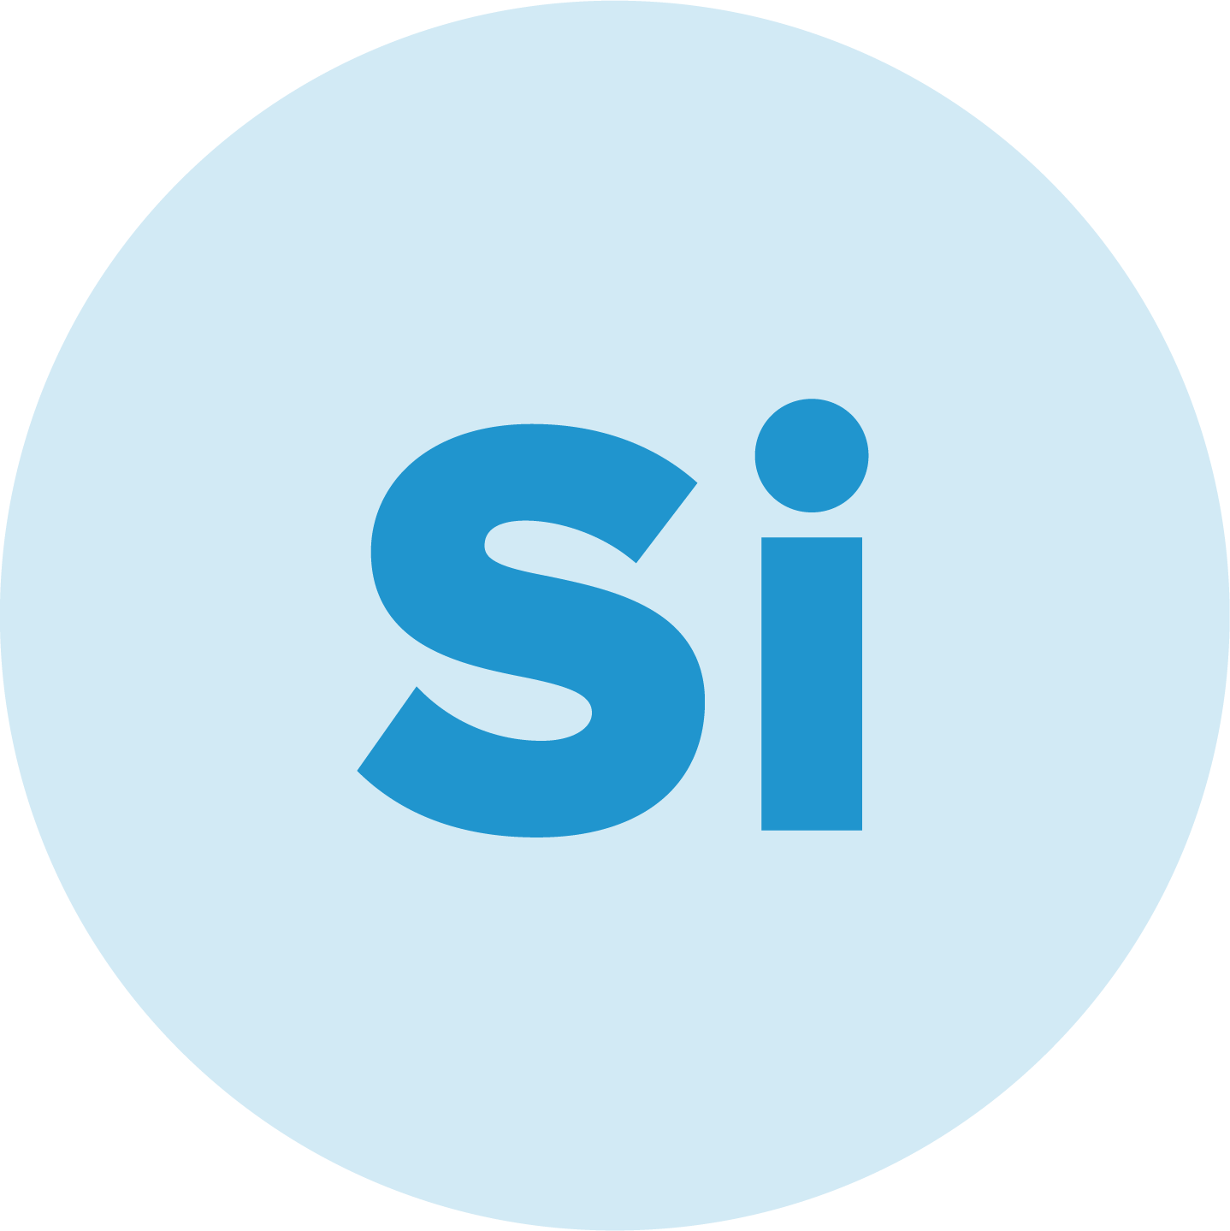


S styles and their priorities
Collaboration
Support
Enthusiasm
Support
Stability
Collaboration
Stability
Support
Accuracy

Slide 15
S style quote
The invariable mark of wisdom is to see the miraculous in the common.
Ralph Waldo Emerson

Slide 16
Communicating with S styles
Be personal and amiable.
Express your interest in them.
Let them know what you expect of them.
Take time to provide clarification.
Be polite.
Avoid being confrontational or too aggressive.

Slide 17

C style
Cautious
Systematic
Private
Objective
Analytical
Diplomatic
Accurate
Reserved

Slide 18

C style
Motivated by opportunities to gain knowledge, showing their expertise, and quality work.
Values quality, accuracy, and challenge.
Fears criticism, slipshod methods, and being wrong.

Slide 19



C styles and their priorities
Stability
Accuracy
Support
Accuracy
Stability
Challenge
Challenge
Accuracy
Results

Slide 20
C style quote
It takes less time to do a thing right than to explain why you did it wrong.
Henry Wadsworth Longfellow

Slide 21
Communicating with C styles
Focus on facts and details.
Minimize “pep talk” or emotional language.
Be patient, persistent, and diplomatic.
Respect their preference to work independently.
Don’t be put off by their more detached approach.
Allow time to get to know each other better to avoid misunderstanding.

Slide 22
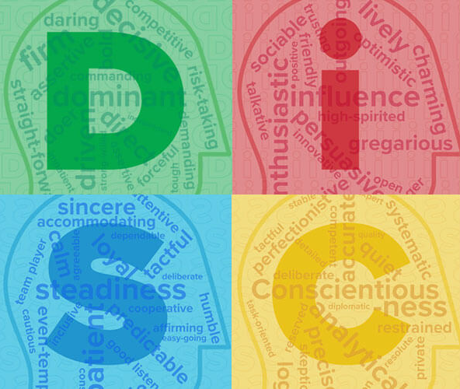
Reminders
All DiSC styles are equally valuable.
Everyone is a blend of all four styles.
People can adapt their styles to fit particular situations or environments.

Slide 23
Learn more at
discprofile.com

