Slide 1
Reviewing DiSC® styles
with Lemony Snicket’s
A Series of Unfortunate Events

Slide 2
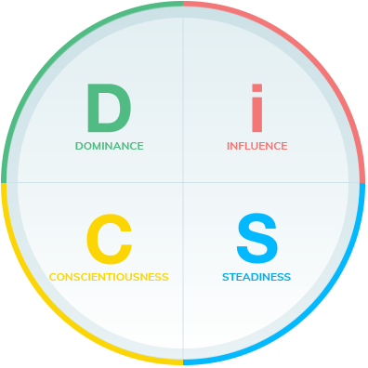
Quotes presented for discussion
We offer these quotes and our opinions about which DiSC style they reflect.

Slide 3
Which DiSC style might need this advice?
Everyone should be able to do one card trick, tell two jokes, and recite three poems, in case they are ever trapped in an elevator.
Lemony Snicket, Horseradish

Slide 4
The C style can struggle with social events.
Everyone should be able to do one card trick, tell two jokes, and recite three poems, in case they are ever trapped in an elevator.
Lemony Snicket, Horseradish

Slide 5
Which DiSC style might agree?
Strange as it may seem, I still hope for the best, even though the best, like an interesting piece of mail, so rarely arrives, and even when it does it can be lost so easily.
Lemony Snicket, The Beatrice Letters

Slide 6
The C style can focus too much on what’s lost or missing or wrong. The i style is the most optimistic.
Strange as it may seem, I still hope for the best, even though the best, like an interesting piece of mail, so rarely arrives, and even when it does it can be lost so easily.
Lemony Snicket, The Beatrice Letters

Slide 7
Which DiSC style might nod their heads in agreement?
It is difficult, when faced with a situation you cannot control, to admit you can do nothing.
Lemony Snicket, Horseradish

Slide 8
The D style wants to be in control.
The S style wants to help.
It is difficult, when faced with a situation you cannot control, to admit you can do nothing.
Lemony Snicket, Horseradish

Slide 9
Which DiSC style might share this frustration?
It is one of life's bitterest truths that bedtime so often arrives just when things are really getting interesting.
Lemony Snicket, The Grim Grotto

Slide 10
The i style hates to miss out.
It is one of life's bitterest truths that bedtime so often arrives just when things are really getting interesting.
Lemony Snicket, The Grim Grotto

Slide 11
Which DiSC style might need this reminder?
There are times to stay put, and what you want will come to you, and there are times to go out into the world and find such a thing for yourself.
Lemony Snicket, Horseradish

Slide 12
The D can have a hard time not acting, the i a hard time with routine, the S with change, the C with looking up from their current focus.
There are times to stay put, and what you want will come to you, and there are times to go out into the world and find such a thing for yourself.
Lemony Snicket, Horseradish

Slide 13
Which DiSC style might need this reminder?
Everybody will die, but very few people want to be reminded of that fact.
Lemony Snicket, The Austere Academy

Slide 14
The D style can be overly blunt and the C style overly focused on facts.
Everybody will die, but very few people want to be reminded of that fact.
Lemony Snicket, The Austere Academy

Slide 15
Which DiSC style might agree?
The table of elements does not contain one of the most powerful elements that make up our world, and that is the element of surprise.
Lemony Snicket, The Ersatz Elevator

Slide 16
The i style is most likely a fan of surprises.
The table of elements does not contain one of the most powerful elements that make up our world, and that is the element of surprise.
Lemony Snicket, The Ersatz Elevator

Slide 17
Which DiSC style might feel this most strongly?
If we wait until we're ready, we'll be waiting for the rest of our lives.
Lemony Snicket, The Ersatz Elevator

Slide 18
The most spontaneous style is the i; the D style tends to be the most impatient.
If we wait until we're ready, we'll be waiting for the rest of our lives.
Lemony Snicket, The Ersatz Elevator

Slide 19
Which DiSC style might feel this most strongly?
It is very unnerving to be proven wrong, particularly when you are really right and the person who is really wrong is proving you wrong and proving himself, wrongly, right.
Lemony Snicket, The Blank Book

Slide 20
The C style fears being wrong.
It is very unnerving to be proven wrong, particularly when you are really right and the person who is really wrong is proving you wrong and proving himself, wrongly, right.
Lemony Snicket, The Blank Book

Slide 21
Which DiSC style might feel this most strongly?
Waiting is one of life’s hardships.
Lemony Snicket, The Reptile Room

Slide 22
The D style is the most impatient, but we probably all agree at times.
Waiting is one of life’s hardships.
Lemony Snicket, The Reptile Room

Slide 23
Which DiSC style might say something similar?
The worst surroundings in the world can be tolerated if the people in them are interesting and kind.
Lemony Snicket, The Bad Beginning

Slide 24
An iS or Si is most likely to agree.
The worst surroundings in the world can be tolerated if the people in them are interesting and kind.
Lemony Snicket, The Bad Beginning

Slide 25
This quote might come from which DiSC style?
Those unable to catalog the past are doomed to repeat it.
Lemony Snicket, The End

Slide 26
The C style is the most inclined to want to catalog events and lessons.
Those unable to catalog the past are doomed to repeat it.
Lemony Snicket, The End

Slide 27
Which style might say something like this?
There are some people who believe that home is where one hangs one's hat, but these people tend to live in closets and on little pegs.
Lemony Snicket, Horseradish

Slide 28
The C style might take things this literally. The i style might enjoy the humor.
There are some people who believe that home is where one hangs one's hat, but these people tend to live in closets and on little pegs.
Lemony Snicket, Horseradish

Slide 29
The S style might be most likely to blame circumstances rather than people.
Bad circumstances have a way of ruining things that would otherwise be pleasant.
Lemony Snicket, Horseradish

Slide 30
The S style might be most likely to blame circumstances rather than people.
Bad circumstances have a way of ruining things that would otherwise be pleasant.
Lemony Snicket, Horseradish

Slide 31
This sounds like which DiSC style(s)?
One can remain alive long past the usual date of disintegration if one is unafraid of change, insatiable in intellectual curiosity, interested in big things, and happy in small ways.
Lemony Snicket, The Penultimate Peril

Slide 32
This is a good reason to try to flex across all the styles.
One can remain alive long past the usual date of disintegration if one is unafraid of change, insatiable in intellectual curiosity, interested in big things, and happy in small ways.
Lemony Snicket, The Penultimate Peril

Slide 33
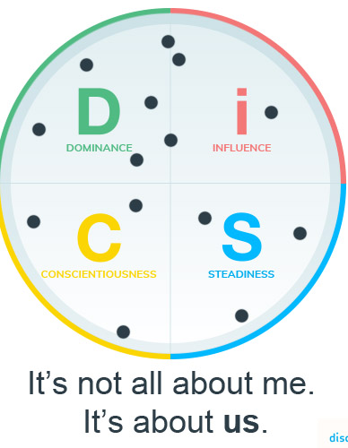
Thanks for playing!
Learn more about DiSC® at discprofile.com

