Slide 1
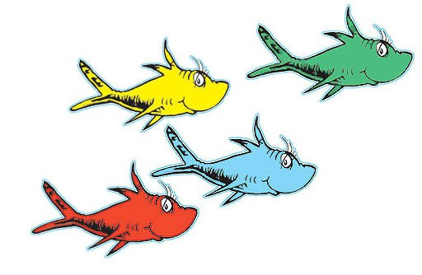

Quoting Dr. Seuss
Quotes to match the DiSC styles
DiSC® is a registered trademark of Wiley.

Slide 2
Answers may differ.
Which DiSC style do you think the quote might resonate with most?
Suggest reasons why the following quotes should or should not apply to your style.
Explain why a quote might apply to your style, but not to you personally.

Slide 3
This might resonate most with which DiSC style?
Why fit in when you were born to stand out?
— Dr. Seuss

Slide 4
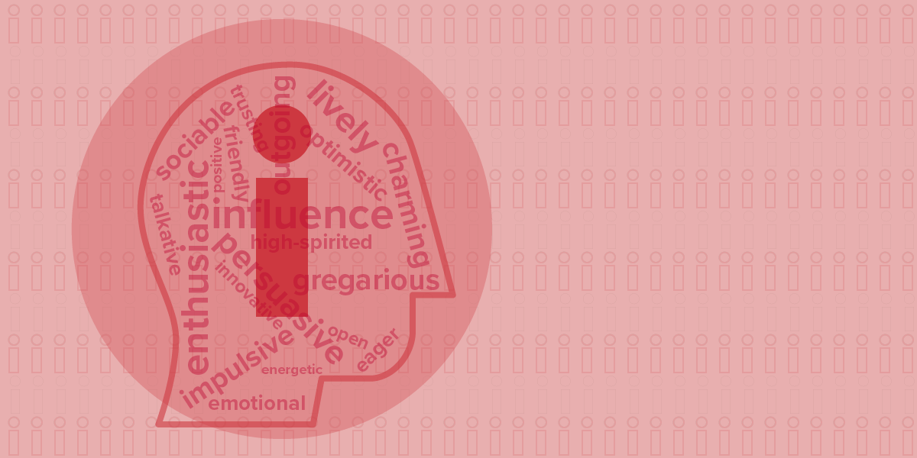
Challenge questions:
How does each style prefer to stand out?
What do they want to stand out for?
Why fit in when you were born to stand out?
Our answer: i style.
They prioritize enthusiasm.
They crave attention, are persuasive and passionate, and are excited by possibilities and new experiences.

Slide 5
This might resonate most with which DiSC style?
Kid, you’ll move mountains!
— Dr. Seuss

Slide 6
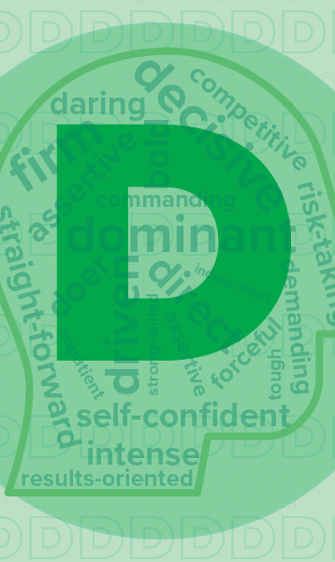
Kid, you’ll move mountains!
Our answer: D style.
They prioritize results, action, and challenge.
They are powerful and decisive.

Slide 7
This might resonate most with which DiSC style?
And will you succeed? Yes you will indeed! (98 and ¾ percent guaranteed.)
— Dr. Seuss

Slide 8

And will you succeed? Yes you will indeed!
(98 and ¾ percent guaranteed.)
Our answer: C style.
They prioritize accuracy, stability, and challenge.
They are conscientious and disciplined.

Slide 9
This might resonate most with which DiSC style?
Unless someone like you cares an awful lot, nothing is going to get better. It’s not.
— Dr. Seuss

Slide 10
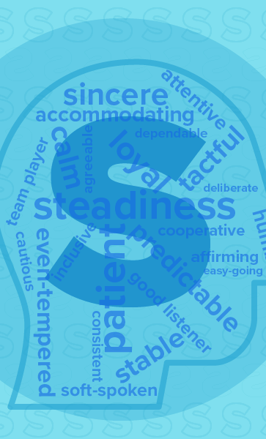
Unless someone like you cares an awful lot, nothing is going to get better. It’s not.
Our answer: S style.
They prioritize support, stability, and collaboration.
They sincerely want to help out and get others involved, too.

Slide 11
This might resonate most with which DiSC style?
Sometimes the questions are complicated and the answers are simple.
— Dr. Seuss

Slide 12
Sometimes the questions are complicated and the answers are simple.
Our answer: D style.
They prioritize results.
They tend to move quickly. They are good at seeing the big picture and are ready to take action.

Slide 13
This might resonate most with which DiSC style?
It is fun to have fun but you have to know how.
— Dr. Seuss

Slide 14
It is fun to have fun but you have to know how.
Our answer: i style.
Their priority is enthusiasm.
Every style knows how to have fun, but the i style is the most likely to try to get you to join in and encourage you to try something new.

Slide 15
This might resonate most with which DiSC style?
Step with care and great tact, and remember that life’s a great balancing act.
— Dr. Seuss

Slide 16
Step with care and great tact, and remember that life’s a great balancing act.
Our answer: S style.
They value support, stability, and collaboration.
They can be sincere, accommodating people who collaborate with others to make decisions where everyone wins.

Slide 17
This might resonate most with which DiSC style?
Oh, the thinks you can think!
— Dr. Seuss

Slide 18
Oh, the thinks you can think!
Our answer: C style.
They are motivated by opportunities to gain knowledge and are both questioning and reflective.
Challenge question: What does each style most enjoy thinking about?

Slide 19
This might resonate most with which DiSC style?
From there to here, and from here to there. Funny things are everywhere.
— Dr. Seuss

Slide 20
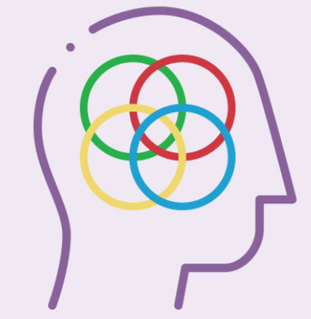
From there to here, and from here to there. Funny things are everywhere.
Our answer: All styles!
We might not all find the same things funny, but we can all laugh. We might snicker, giggle, guffaw, chuckle or chortle. We all know how.

Slide 21
Find more at discprofile.com
What is DiSC?
How DiSC works
DiSC® activities and training materials

