Slide 1
Vision
Activities for Everything DiSC® Work of Leaders

Slide 2
Vision
“Experienced leaders didn’t say that vision was just critical to their work. … They said vision is critical to every leader's work.”

Slide 3
What is your vision?

Slide 4
Vision
Does it make you stand out from your competitors?
Does it provide a sense of purpose?
Does it drive the creation of your goals?
Does it spark imagination?
Is it energizing?

Slide 5
Samples
Nike’s mission statement is “To bring inspiration and innovation to every athlete* in the world.” *The legendary University of Oregon track and field coach and Nike co-founder Bill Bowerman said, “If you have a body, you are an athlete.”
Google’s mission is to organize the world’s information and make it universally accessible and useful.

Slide 6
Organizations intent on building shared visions continually encourage members to develop their personal visions. If people don’t have their own vision, all they can do is sign up for someone else’s. The result is compliance, never commitment.
Peter M. Senge, The Fifth Discipline

Slide 7
As a leader, which of the following do you find more difficult?
Source: The Work of Leaders

Slide 8
Vision through exploration
“Give yourself permission to set aside specific time to let your mind wander, to think about the possibilities.”

Slide 9
Do you need help remaining open?
Seek closure Remain open
Discuss ways to avoid locking in on a plan or idea and trying to implement too quickly.

Slide 10
Prioritize the big picture
“Why do we exist?”
“How do we behave?”
“What do we do?”
“How will we succeed?”
“What is most important, right now?”
“Who must do what?”
– Patrick Lencioni, The Advantage

Slide 11
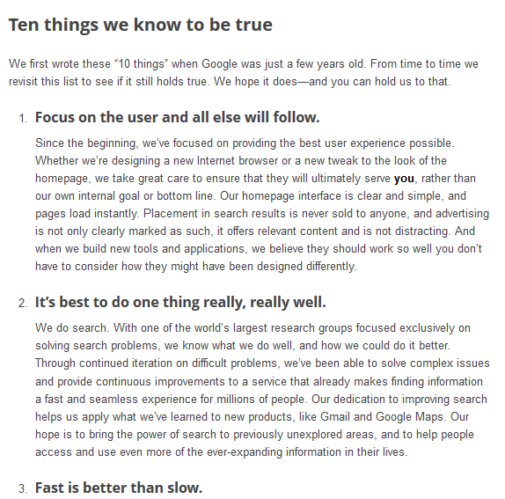
Example

Slide 12
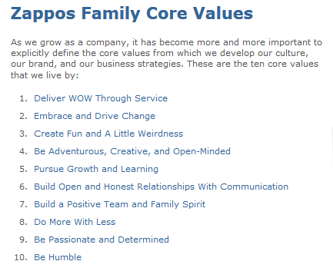
Example

Slide 13
Do you need help focusing on the big picture?
Prioritize details Prioritize big picture
Discuss ways to look outside day-to-day responsibilities toward the bigger picture.
How do you keep details from bogging you down?

Slide 14
Do you need help focusing on the big picture?
Prioritize details Prioritize big picture
Write your organization’s obituary.
Who did the brand leave behind?
What did the brand leave unaccomplished?
Who will mourn or miss the brand, and why?

Slide 15
Preparing your vision
What is your sphere of influence?
Who looks to you for direction and motivation?
How will your vision relate to the larger organizational vision?

Slide 16
Vision: Assignment
Draft a vision statement. (A bold idea; not a mission statement.)
Doodle around your themes. Make a mind map. Play with your ideas.

Slide 17
Vision through boldness
“The effective leader understands that a disruption to stability is sometimes necessary for growth (or even survival).”

Slide 18
Vision through boldness
“Don’t apologize for your ideas or back down too quickly. Instead of saying, ‘I know this is a bad idea,’ say ‘I know this is a bold idea.’”

Slide 19
Vision: Assignment
Edit your draft vision.
What assumptions are you making about how it will be accepted, how it will work, if it’s energizing, if others will understand it, etc.?

Slide 20
Do you need help?
Cautious Adventurous
Hold back Speak out
Discuss ways to be more adventurous and able to speak boldly.

Slide 21
Testing your assumptions
“What am I missing here? What else should I know?”
Who can you go to for counsel?
Customers
Customer’s customers
Trusted advisor
Teams in other departments
Peer in another industry
Board
Investors
Vendors

Slide 22
Testing your assumptions
Ask, “What do you know that could disprove or support my assumptions?”
Socialize your idea. Let others interact with it. See how it holds up.
Practice listening, not selling or persuading at this point.
Share with your group your plan for socializing your draft vision.

Slide 23
What’s your image?
What’s your image of a leader?
Have these exercises changed your image?

Slide 24
Traditional images of leadership didn’t assign much value to relating. Flawless leaders shouldn’t need to seek counsel from anyone outside their tight inner circle, the thinking went, and they were expected to issue edicts rather than connect on an emotional level. Times have changed, of course, and in this era of networks, being able to build trusting relationships is a requirement of effective leadership.
In Praise of the Incomplete Leader, Harvard Business Review, Feb. 2007

Slide 25
Would your followers agree?
My leader…
is active about finding new opportunities.
focuses on improving our methods.
rallies people to achieve goals.
encourages our group to stretch our boundaries.
is open to input from others.

Slide 26
Learn more at discprofile.com
Activities for Work of Leaders trainings
Work of Leaders supplemental readings
The book: The Work of Leaders: How Vision, Alignment, and Execution Will Change the Way You Lead

