Slide 1
Quotes on leadership
From The Work of Leaders book

Slide 2
We tend to think that what matters is having outstanding leadership at the senior level. But great leadership at the top doesn’t amount to much if you don’t have exceptional leadership at the unit level. That’s where great things get done.
The Re-Education of Jim Collins, Inc.

Slide 3
The Work of Leaders
The Work of Leaders: How Vision, Alignment, and Execution Will Change the Way You Lead
Quotes in these slides are from this book unless otherwise noted.

Slide 4
Leaders have three fundamental responsibilities: They craft a vision, they build alignment, and they champion execution.
Work of Leaders model

Slide 5
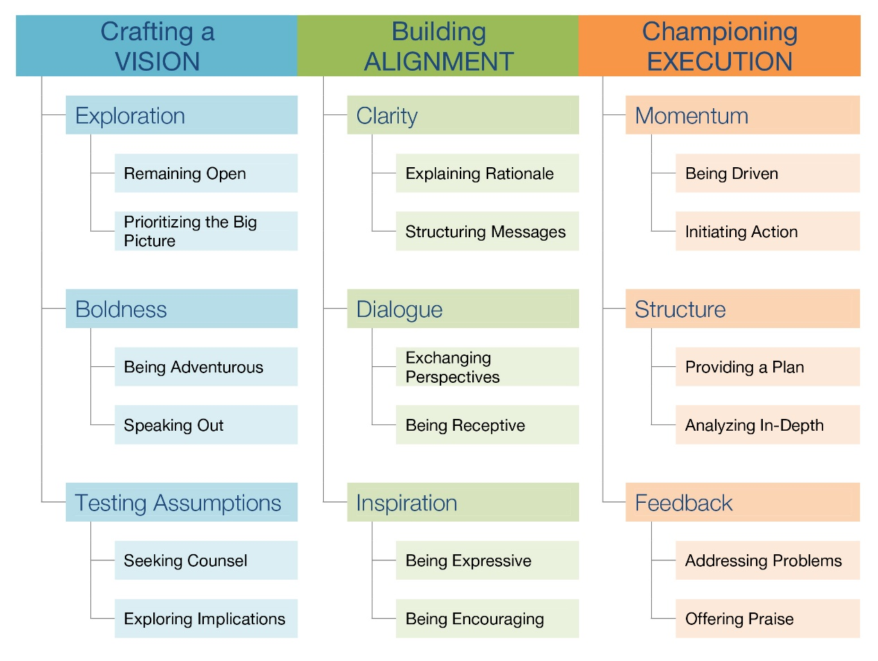
Work of Leaders model
Vision
Alignment
Execution
Everything DiSC Work of Leaders

Slide 6
Vision
Imagining an improved future state the group will make a reality

Slide 7
Experienced leaders didn’t say that vision was just critical to their work... . They said vision is critical to every leader’s work.

Slide 8
A powerful vision can help everyone understand how whatever you do is differentiated from what your competitors do.

Slide 9
If you’ve ever been part of an energized team, whether around a conference room table or on a playing field, you know the feeling of pulling together to reach a common goal: suddenly everyone’s work becomes essential and meaningful.

Slide 10
Organizations intent on building shared visions continually encourage members to develop their personal visions. If people don’t have their own vision, all they can do is sign up for someone else’s.
Peter Senge, The Fifth Discipline

Slide 11
Vision → Exploration

Slide 12
Remaining open doesn’t mean you’re indecisive. It’s about making a conscious decision to invest time in exploration. It’s not that you can’t make up your mind—it’s about not making a decision too early.

Slide 13
Give yourself permission to set aside specific time to let your mind wander, to think about the possibilities.

Slide 14
Don’t reject an idea just because you aren’t sure how it will be implemented.

Slide 15
This is the single most requested behavior change for leaders: “Be more active about finding new opportunities.”

Slide 16
Talk to your customers. Talk to your customer’s customers. Talk to other teams in other departments. Talk to vendors.

Slide 17
Vision → Boldness

Slide 18
The effective leader understands that a disruption to stability is sometimes necessary for growth (or even survival).

Slide 19
If a leader is not able to muster an inner spirit of boldness, it limits the leader’s ability to move forward.

Slide 20
Only a fraction of the leaders we’ve studied describe themselves as highly adventurous. Meanwhile, “Do more to help us stretch the boundaries” is one of the most common request we hear people give their leaders.

Slide 21
If the idea really is powerful, analysis and ingenuity can sometimes turn the impractical into: “You know, we might actually be able to do this.” That realization, however, is never going to come to light if the leader doesn’t have the strength to introduce it.

Slide 22
Remember that speaking out with a bold idea doesn’t necessarily have to be done impulsively or on the spur of the moment. … By pitching it informally, you’ll gain a sense of how people are going to react and the opportunity to polish your delivery.

Slide 23
Vision → Testing assumptions

Slide 24
By understanding as much as possible about your vision, you’ll be able to anticipate the potential reactions and challenges. You can’t deal with problems you don’t know about.

Slide 25
Seeking counsel is about inviting people whose skills and knowledge you respect into the process. This is your chance to try out your vision while the stakes are still low…. It isn’t asking someone for approval.

Slide 26
There’s no reason to limit yourself to consulting with your co-workers. Consider other people you know who might have fresh perspectives that could be useful in refining your ideas, especially those closest to your customers.

Slide 27
But in the end, the leader has to apply judgment, asking herself how bold to be and how much to listen to critics and naysayers.

Slide 28
Alignment
Everyone in the group understands and commits to the direction.

Slide 29
Building alignment is the logical next stage after crafting a vision. Building alignment is the act of gaining buy-in for your vision and it’s absolutely critical in moving from imagination to reality.

Slide 30
Our research shows that more than half of leaders report little or no training or guidance in the practice of creating alignment. In fact, only 47 percent report having a clear understanding of what “building alignment” even means in the context of leadership.

Slide 31
Effective leaders also understand that alignment is not something to check off a to-do list. Alignment is a dynamic, ongoing process that requires continual monitoring and realigning as conditions and needs change.

Slide 32
True alignment changes the way team members view their actions; they embrace team decisions and organizational actions as if they were their own.

Slide 33
Alignment → Clarity

Slide 34
When both rational and emotional needs are met, when leaders reach the head and heart, true alignment goes beyond enthusiasm, beyond agreement, beyond understanding goals.

Slide 35
But if you’re able to give a simple reason for a change or new plan, people should be able to follow your logic and reach the same conclusions. Usually, the more unpopular or demanding a change is, the more important it is to give people a solid reason.

Slide 36
If people aren’t given explanations in a straightforward manner, they’ll often unintentionally make them up. … The solution? Be proactive. Over-clarify and over-communicate when the situation calls for it.

Slide 37
But there is no easy way out if you want the benefits of clarity working for you. You have to take time to structure your message.

Slide 38
We asked more than 16,000 people to tell us about the leaders they enjoy working with most. The leaders who consistently rose to the top were those who genuinely listen to other people and take others’ input and ideas seriously.

Slide 39
When leaders encourage (or even reward) vulnerability, people can express their true doubts and concerns. They don’t need to worry about how they’ll be perceived. And … they don’t have to worry about tap dancing around the leader’s ego.

Slide 40
Execution
Conditions are present for the imagined future to be turned into reality.

Slide 41
Complimenting people is important, but how it happens should be personal and fit the accomplishment. Furthermore, be sure to go beyond the simple “good job.” Be specific and paint a picture of the difference the person is making.

Slide 42
You’re the role model who demonstrates there is nobility to acknowledging my mistakes and growing from them.

Slide 43
Commit your team to deadlines related to external events, for example, a major conference or the end of the fiscal year. An external commitment is always harder to break— someone else is waiting, counting on you.

Slide 44
Our research shows that inexperienced leaders may find it more difficult to drive people to push themselves harder. Experienced leaders not only know this is part of their jobs, but they’ve grown much more comfortable playing this role in the group.

Slide 45
You can create an environment that leads to more effective execution. As the leader, you can instill a sense of the possible in an organization or team, and a personal and tangible feeling that each contribution is a step toward realizing a vision.

Slide 46
When you think of all the sources of negativity that can creep into the work environment (setbacks, delays, complaining, arguments, or criticism), someone should be infusing positivity into the situation. The leader is that someone.

Slide 47
If you have a handle on why your work is important, you’re halfway there. The next step is putting it into words and sharing a sense of purpose with the group. Crafting a picture of how amazing this will be when the team reaches its goals creates a positive energy.

Slide 48
This is consistent with the finding that leaderless groups have a natural tendency to elect self-centered, overconfident and narcissistic individuals as leaders, and that these personality characteristics are not equally common in men and women.

Slide 49
This image of a leader inspiring a team is almost synonymous with leadership. And yet, our research suggests that this is one of the areas leaders neglect the most.

Slide 50
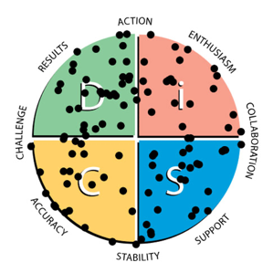
Leaders can be any DiSC® style

Slide 51
Learn more at Discprofile.com

