Slide 1
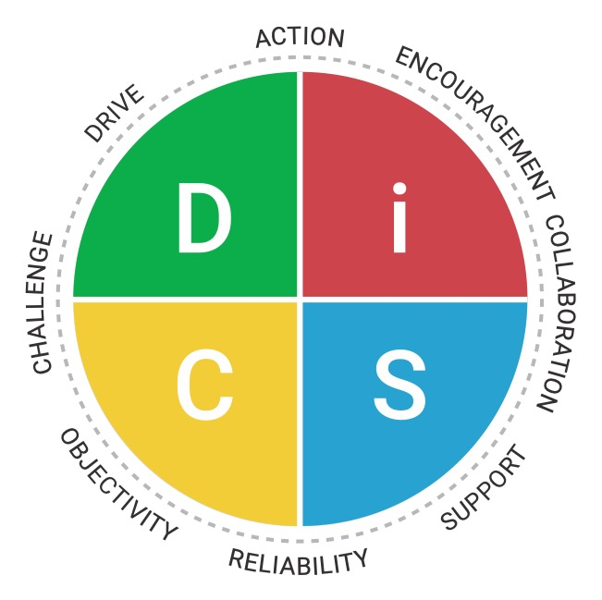
Everything DiSC® Management Motivators
Pushing the team toward new opportunities
Ensuring the team gets quick, efficient results
Infusing energy and optimism into the team
Pushing to ensure the highest standards are achieved
Ensuring trusting relationships so everyone can do their best
Creating fair, efficient systems and processes
Helping people who are struggling
Creating consistency, clarity, and stability so people can succeed
X

